Slide 1

Spotify Study Playlists
Presented by Christy Sato

Slide 2
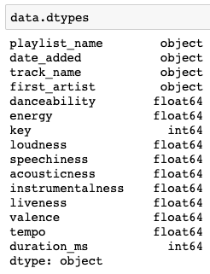
Data Description
Data Sources:
Spotify API
Tracks, artists, and features of songs (danceability, energy, etc) in a playlist
2,316 observations (songs) and 15 columns
20 study playlists, 9 other
MongoDB
#studyplaylists, #studysongs, #studymusic
74 tweets

Slide 3
Analysis Question Description
What features of songs make it a good study song in a study playlist?
What are the significant differences from a study playlist and other genre playlists?
What is the frequency of words in a collection of tweets that includes #studyplaylists?

Slide 4
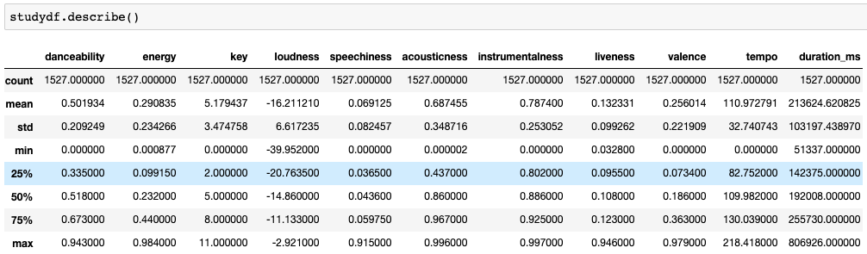




Study Playlists

Slide 5
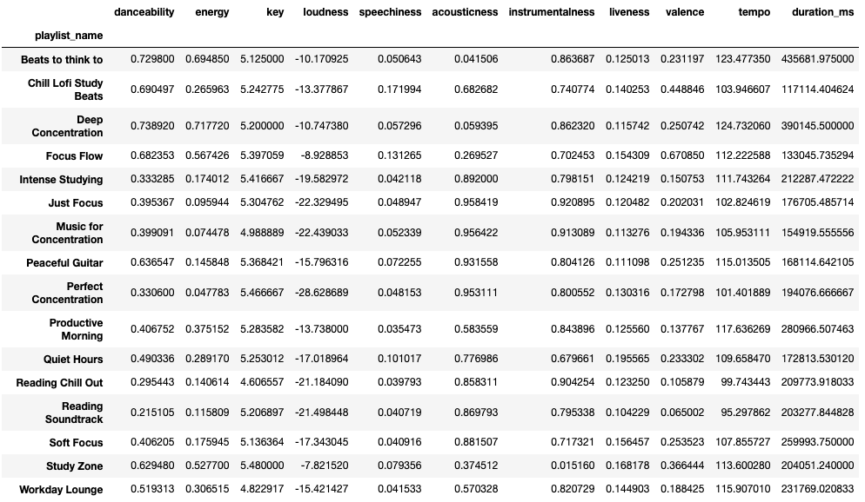
Key takeaways:
Playlists have different types of songs which affect the features
Best study playlists depends on the user’s preferences

Slide 6
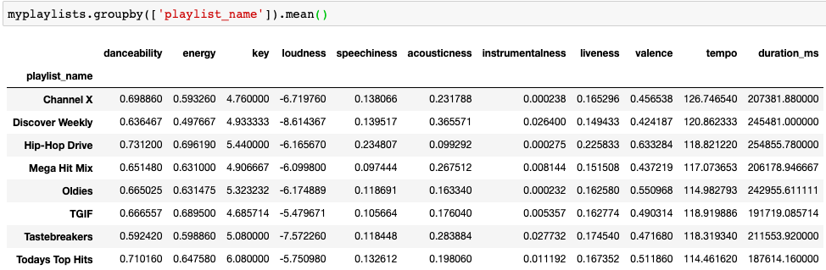
Comparison to Other Genre Playlists

Slide 7
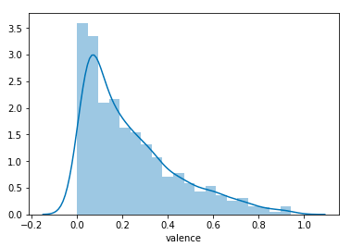
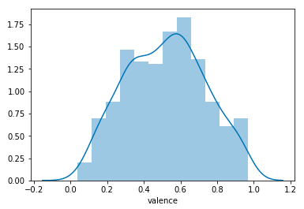
Study Playlists
My Playlists
Valence = how positive(happy) or negative songs are

Slide 8
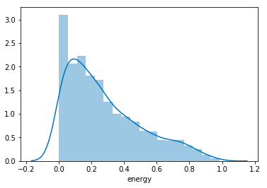
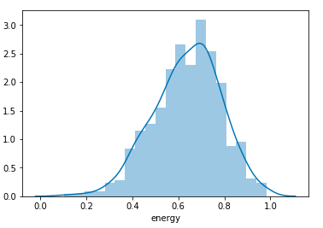
Study Playlists
My Playlists

Slide 9
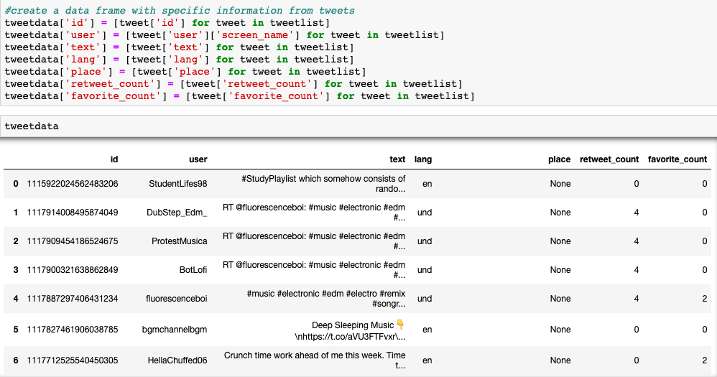
Study Playlist Tweets

Slide 10
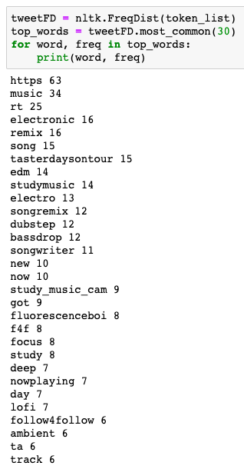
Most Frequent Words
Import nltk and SentimentIntensityAnalyzer
Tokenize all the tweets
1975 tokens
Lower case all the tokens
Remove all the stopwords
Remove all unnecessary symbols

Slide 11
Questions?

